Slide 1



MFIX-DEM Enhancement towards Industrially-Relevant Flows
Peiyuan Liu
Dept. of Chemical Engineering
University of Colorado Boulder
Project leads:
Dr. Ray Cocco (PSRI, co-PI)
Dr. Ray Grout (NREL, co-PI)
Prof. Thomas Hauser (Univ. CO, co-PI)
Prof. Christine Hrenya (Univ. CO, PI)
Funding by the U.S. Department of Energy under Grant No. DE-FE0026298
Workshop on Multiphase Flow Science
August 10 2016

Slide 2
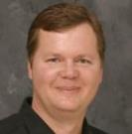

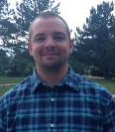
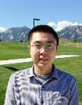


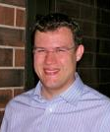

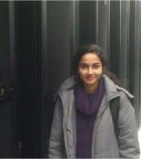


Team
University of Colorado
Chemical & Biological Engineering
DEM modeling of granular and gas-solid flows, MFIX
University of Colorado
Research Computing
High-performance computing, CFD
Prof. Thomas Hauser
Prof. Christine Hrenya
Dr. William Fullmer
Dr. Peiyuan Liu
NREL
Computational Science
High-performance computing, CFD
PSRI
Industrial Application and Experiments of Particle Flows
Tim Brown
Aaron Holt
Dr. Ray Grout
Dr. Hari Sitaraman
Dr. Deepthi
Vaidhynathan
Dr. Ray Cocco
Dr. Allan Issangya
Notes:
Our team is formed by a collaboration of engineering and computation scientists. Professor Christine Hrenya from CU is leading the team with expertise in DEM and multiphase flow modelling. Professor Thomas Hauser, who is the director of research computing at CU and Dr Ray Grout at NREL are leading the computational experts. Dr. Ray Cocco from PRSI will be help us with industrially relevant experiments.

Slide 3
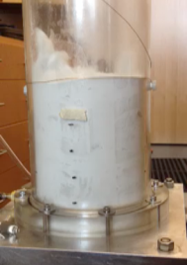
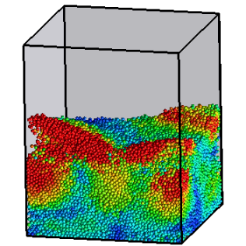
Motivation
?
DEM-CFD
Experiments
N_{p} ~ 10⁴ - 10⁶
N_{p} ~ 10¹⁰
TFM
DEM-CFD
DNS
  Motivation:
  DEM application toward industrially relevant systems
More detail, fewer closures
Less CPU time
van der Hoef et al, Annu. Rev. Fluid Mech 2008
Notes:
The motivation of this project is to extend the current MFIX-DEM towards industrially relevant flows. As shown on the left, compared with TFM and DNS, DEM is gaining popularity as it has the advantage of less closures and more tractable computational time. However, simulation industrially problems with DEM is still a challenge. As shown on the right, lab-scale experiment of a fluidized is commonly containing 4~6 order of magnitude more particles than state-of-art DEM can handle. When drawing to scale, the DEM geometry disappears, questioning the predictions obtained from the simulations.

Slide 4
Outline
Objective: MFIX-DEM toward industrially relevant problems
Industrial Survey
Define Benchmark Cases
Profiling Benchmark Cases
Preliminary Results
Notes:
Here is outline of the progress we made to approach our goal. First we conducted industrial survey to understand their needs. Next we defined representative benchmark cases and performed profiling to understand the current capability of the MFIX-DEM. Finally we will show some preliminary results where we can demonstrate the enhanced performance via our modifications of the code.

Slide 5
Understanding Industry Needs: Survey by PSRI
Sectors distribution of 18 respondents
DEM usage
Software packages
Expected value added through DEM
Percentage
Notes:
First, we talk about the industrial survey, which covers a wide of distribution of industrial sectors as shown on the left. In terms of DEM usage, 67% are using CFD and DEM and most of them are using commercial packages. And They are all very optimistic about DEM and over 80% would expect DEM to provide valuable information for their industry.

Slide 6
Understanding Industry Needs: Survey by PSRI
Acceptable turnover time
No. of companies
Cocco, R., Fullmer, W.D., Liu, P., Hrenya, C.M., CFD-DEM: Modeling the small to understand the large (submitted). Chem. Eng. Prog.
Notes:
In terms of computational consideration, over 70% cares about the speed, suggesting the need to enhance the current capability of DEM. In addition to speed, they are also concerned with the physics that DEM can hand, including antiparticle force, particle shape and attrition. From 1 week to 1 month is time range that they are willing to wait for a DEM simulation to complete, giving us a guideline on the extent to enhance the current DEM codes.

Slide 7
Outline
Objective: MFIX-DEM toward industrially relevant problems
Industrial Survey
Define Benchmark Cases
Profiling Benchmark Cases
Preliminary Results
Notes:
To understand the current capability of MFIX-DEM, we have developed the following benchmarks

Slide 8
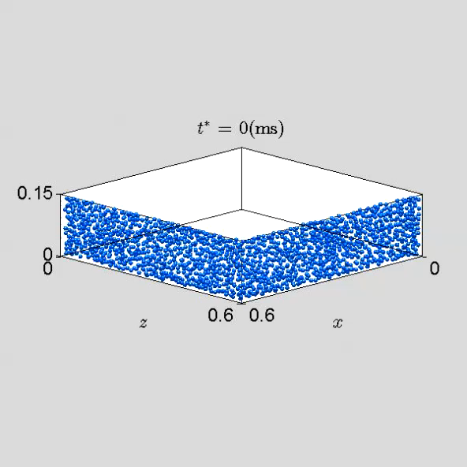
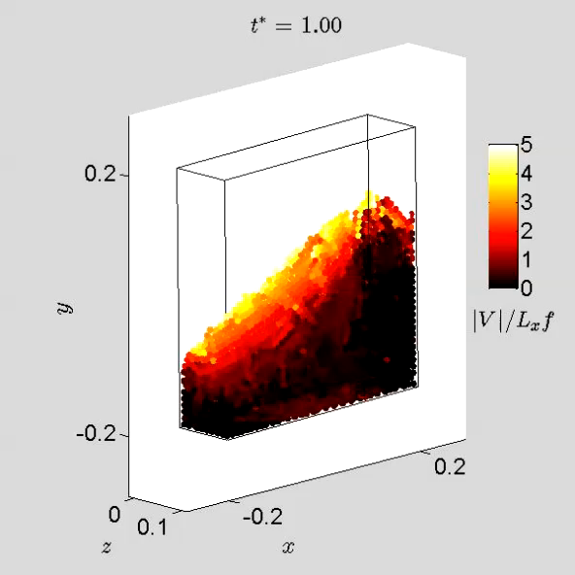
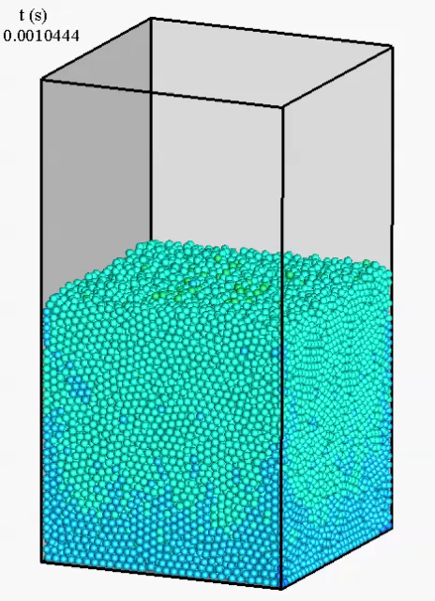
Profiling MFIX-DEM: Benchmark cases
v (cm/s)
Settling
Square tumbler
Fluidized bed
  Dense, enduring contacts
Notes:
Benchmark – settling system looks like particles not throughout 3D system – mention verbally why
-indicate at least verbally that cases contain range of dilute and dense, include instabilities (bubbling and clusters), etc.

Slide 9
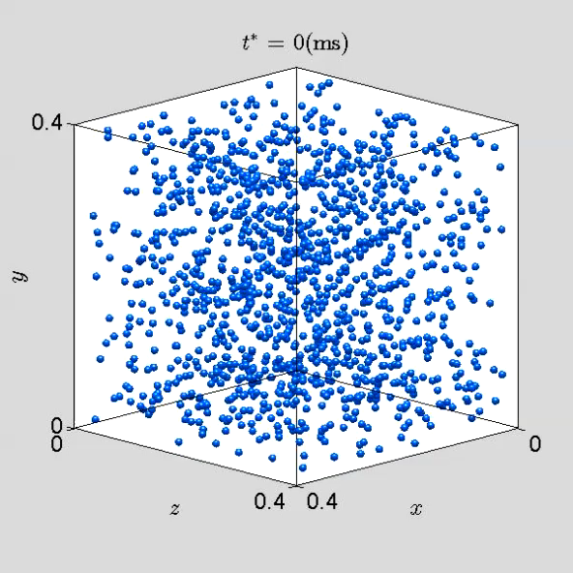
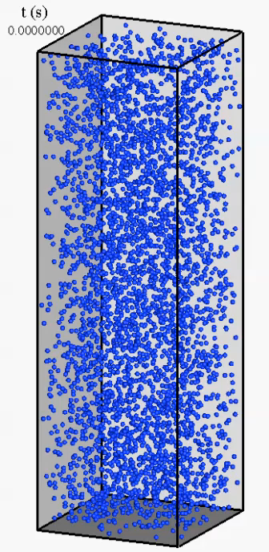
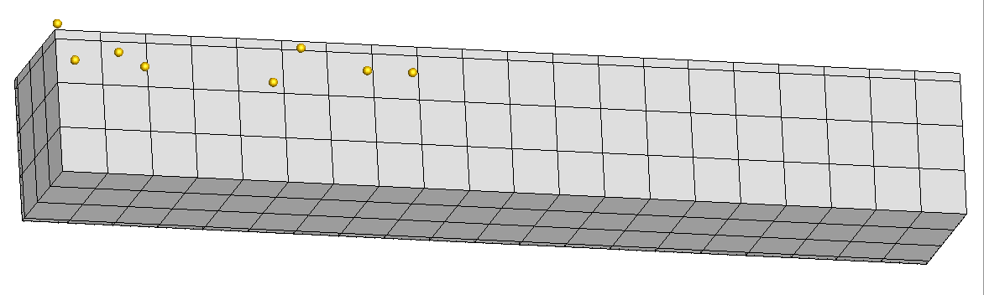
Profiling MFIX-DEM: Benchmark cases
v (cm/s)
Homogeneous cooling
Riser flow
  Dilute, nearly instantaneous collision
θ = 45°
v (cm/s)
Ramp flow
g

Slide 10
Outline
Objective: MFIX-DEM toward industrially relevant problems
Industrial Survey
Define Benchmark Cases
Profiling Benchmark Cases
Preliminary Results

Slide 11
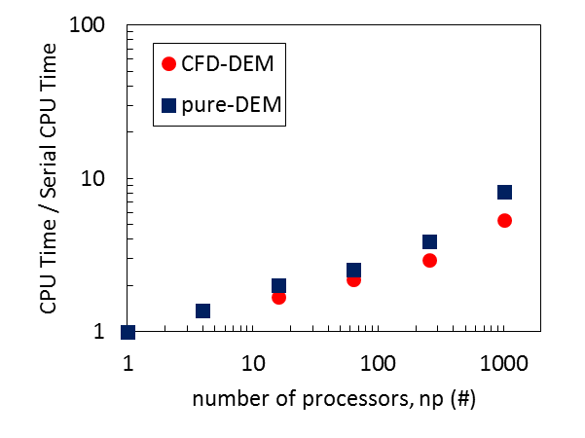
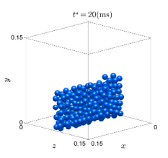
Profiling MFIX-DEM: Dense systems
Contact force computation
Weak scaling analysis
Settling
Weak Scaling: change in CPU time with increasing np for an increasing problem size that scales with np
Gas-solid coupling
Fluidized bed
MFIX-2015-1
Intel(R) Xeon(R) CPU X5660 @ 2.80GHz,
24 Processors per node, 24 GB RAM per node

Slide 12
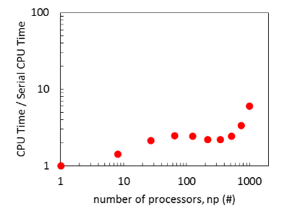
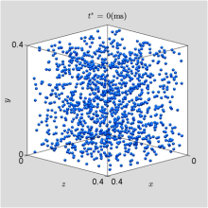
Profiling MFIX-DEM: Dilute systems
Gas-solid coupling
Weak scaling analysis
HCS
Fluid solver functions
Riser flow
MFIX-2015-1
Intel(R) Xeon(R) CPU X5660 @ 2.80GHz,
24 Processors per node, 24 GB RAM per node
Notes:
stabilized biconjugate gradient (BiCGSTAB) method

Slide 13
Profiling MFIX-DEM: Performance assessment
Loop metrics: Percentage of CPU time the benchmark simulations spend in vectorized loops, scalar loops, and outside of loops
Targeted improvements
Enhance vectorization → better utilization of single instruction, multiple data (SIMD) registers supported by current and future processors

Slide 14
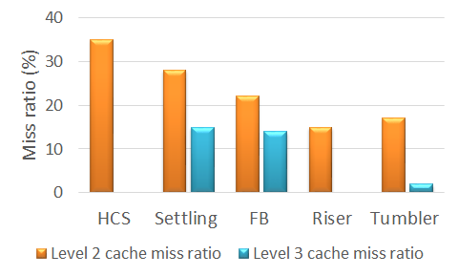
Profiling MFIX-DEM: Performance assessment
Miss ratio: the ratio of memory accesses that cause a cache miss.
Targeted improvements
  Reduce Level 2/Level 3 cache miss ratio → locality of data to the processors
Notes:
L3 cache is just a larger, slower version of the L2 cache

Slide 15
Outline
Objective: MFIX-DEM toward industrially relevant problems
Industrial Survey
Define Benchmark Cases
Profiling Benchmark Cases
Preliminary Results

Slide 16
Preliminary Results:
General floating point optimization (Drag calculation)
Expressions with divisions and repeated operations in BVK drag
F = 10d0*phis/EPg**2 + EPg**2*(ONE+1.5d0*DSQRT(phis))
F = F + 0.413d0*RE/(24.d0*EPg**2) * (ONE/EPg + 3d0*EPg*phis + 8.4d0/RE**0.343) / (ONE+10.d0**(3d0*phis)/RE**(0.5+2.d0*phis))
Optimize using
    Pre-calculated variables
    Avoid divisions
    Use a local cache for memory aligned access
local_array(1)=ONE/EPG/EPG
local_array(2)=ONE/EPG
local_array(3)=EPG
local_array(4)=EPG**2
local_array(5)=ONE/RE
F = 10d0*phis*local_array(1) + local_array(4)*(ONE+1.5d0*DSQRT(phis))

Slide 17
Preliminary Results: Spatial sorting of particles
7
12
2
5
10
4
6
13
1
3
15
8
1
4
10
11
14
6
12
8
16
5
7
9
17
2
13
15
17
3
11
9
14
16
Spatial sorting (done at beginning of des time march)
→ increase spatial data locality in memory while
    Finding neighbors
    Calculating inter particle forces
    Drag calculations
    Interpolating mean fields.

Slide 18
Preliminary Results: State-based sorting of particles
Particle array
n | n | ghst | X | n | n | ghst | X | n | n
Sorted Particle array
n | n | n | n | n | n | ghst | ghst | X | X
Np_normal
MAX_PIP_EXIST
General particle loop structure
Scalar loop
Do i=1,MAX_PIP
If not a normal particle cycle
If nonexistent particle cycle
!Do operations
A(i) = B(i) + C(i)
End Do
Use NP_NORMAL or MAX_PIP_EXIST
Vectorized loop
A = B + C
With sorted particle Array
Remove “if” constructs to aid in vectorization

Slide 19
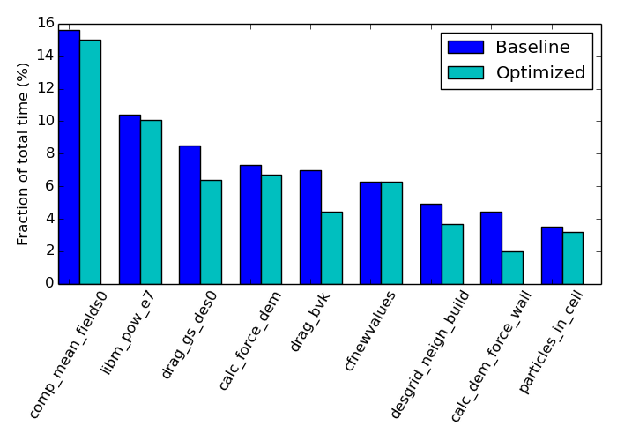
Preliminary Results: Sorting and drag
Square tumbler (~9000 particles on 20 x 20 x 5 grid)
State based and spatial sorting
Drag optimization
Spatial sorting
Optimized code showed an overall ~10% improvement
Data cache misses reduced by 50%.
Parameters | Original | Optimized
L2 to L1 cache miss ratio (Data) | 0.369 | 0.149
L2 to L1 cache miss ratio (instruction) | 0.629 | 0.567
Notes:
These are run on Intel Haswell cores on CU machine with intel 16 compiler. Compiler flags are –O2 –g. The cost of
Sorting is less than 1% of total run time. These results are from second quarterly report. The baseline run time is 530 sec for
~ 80000 des time steps.

Slide 20
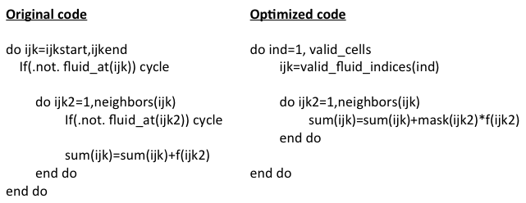
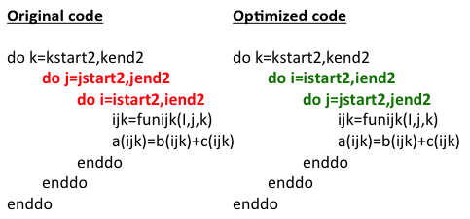
Preliminary Results: Fluid cell operations
Sorting
ijkindex
Cell data
n | n | ghst | Np=0 | Np=0 | n | ghst | n | Np=0 | n
Cell data
n | n | n | n | n | ghst | ghst | Np=0 | Np=0 | Np=0
      Fluid_mask(ijk)=1 (if fluid_at)
      Fluid_mask(Ijk)=0 (otherwise)
Masking
Swap loop indices
3
6
9
2
5
8
j direction
1
4
7
Removal of “if”
Contiguous memory access
      Extremely expensive
i direction

Slide 21
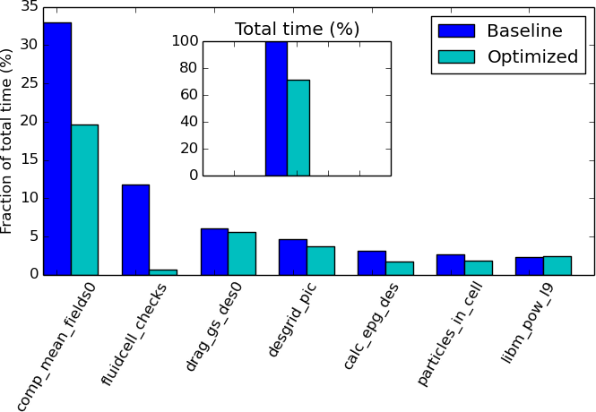
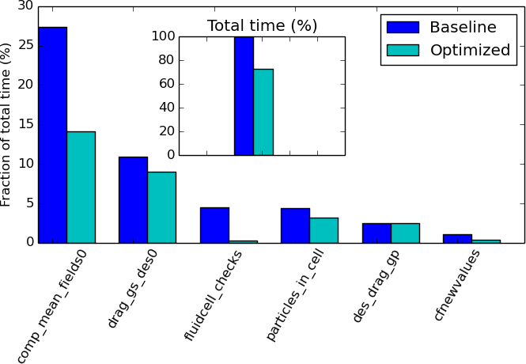
Preliminary Results: Fluid cell operations
Serial HCS test case (~1200 particles)
Serial HCS test case (~33000 particles)
Compiler vectorizes subroutines like comp_mean_fields when the “if” conditions are removed. Time spent on fluid cell checks also reduce significantly.
Optimized code showed an overall ~30% improvement
Notes:
These runs are on NREL machine using intel haswell cores and intel 16 compiler. Baseline hcs small case run took 610 seconds,
Baseline hcs big case took 3215 seconds.

Slide 22
Summary
So far…
Profiling and optimization only applied to serial MFIX-DEM
Next steps…
Focus on improving parallel performance - i.e. tackling poor weak scaling in MFIX-DEM via
    Reducing MPI communication overhead
    Load-balancing
Industrially relevant problem demonstration
Uncertainty quantification

Slide 23
Back up slide: Task list
Task 1 - Project Management and Planning
Task 2 - Profiling MFIX DEM
  Task 2a: Benchmark serial MFIX DEM
  Task 2b: Benchmark parallelized MFIX DEM
Task 3 - Determine Optimization Frameworks
Task 4 - Perform optimization and vectorization of serial DEM
  Task 4a: Employ optimization techniques
  Task 4b: Verify enhanced DEM code for numerical correctness
Task 5 - Optimize and enhance hybrid (MPI + accelerator) DEM
  Task 5a: Implement hybrid parallelization method (MPI + OpenMP)
  Task 5b: Use extensive parallel profiling to optimize parallel code
  Task 5c: Compare enhancements on multiple Xeon/Xeon Phi architectures
Task 6 - Industrially Relevant Problem
Task 6a: Survey of PSRI member companies
Task 6b: Experiments of Interacting Nozzles
Task 7 - Uncertainty Quantification
  Task 7a: Test Problem
  Task 7b: Challenge Problem
  Task 7c: Industrially Relevant Problem

Slide 24
Back up slide: Computational Project Goals
Improve the computational performance of MFIX-DEM
  Create a set of benchmarks to guide optimization work
  Profile benchmarks
  Improve serial performance of select subroutines by a factor of 2
    Vectorization
    Optimization of memory access
  Improve parallel performance of MFIX-DEM
    Hybrid OpenMP + MPI parallelization
Demonstrate performance enhancements through DEM simulation with O(10⁸) particles
Explore algorithmic changes

Slide 25
Back up slide: Profiling MFIX-DEM: Summary
Current Capability
10³ N_{p}/core: Good speed for quick turn-around
10⁴ N_{p}/core: Slow, but likely acceptable
10⁵ N_{p}/core: Too slow for R&D turn-around
Space for optimization to enable industrial relevant simulations
  Poor weak scaling
  Low vectorization of inner loops
  High number of cache misses
For a goal to simulate 10⁸ particles
10³ N_{p}/core ⋅ 10⁵ cores: Unrealistic industrial
capability
10⁴ N_{p}/core ⋅ 10⁴ cores: Sweet spot, but serial speed
up needed and scalability for
cores >10³
10⁵ N_{p}/core ⋅ 10³ core: MFIX-DEM too slow

Slide 26
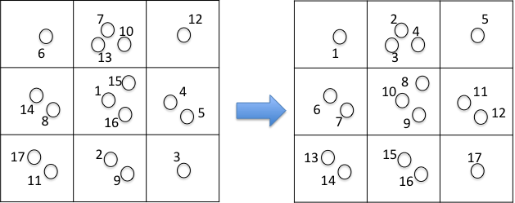
Back up slide: Algorithm for spatial reordering of particles
dg_pic array is used to get the new ordering
Sorting_map and inverse sorting map is created
  sorting_map(1) = 6 (map from new id to old id)
  inv_sorting_map(1) = 10 (map from old id to new id)
  A copy of inverse sorting map is sorted
    a preferred sorting algorithm is used(quick sort/bubble sort)
    Particle data are swapped according to swaps in the sorting.
    The sorting maps are used to set the neighbor arrays

Slide 27
Back up slide: Sorting neighbor arrays
Neighbor information (human readable)
MFiX data structure
particles
2
3
4
3
5
4
5
4
6
8
9
9
Neighbors(:)
Neighbor_index(:)
1
2
3
4
5
2 | 3 | 4 | 5 | -
3 | 5 | 5
4
neighbors
When sorting arrays based on state
  Particles are exchanged (ie say part. 1 becomes part. 4)
  When sorting neighbor arrays
    Need to populate new ids
    Need to adjust neighbor_index
    Need to offset sets of indices

Slide 28
Back up slide: Swap loop indices
General loop structure
DO IJK = IJKSTART3,IJKEND3
I = i_of(ijk)
j = j_of(ijk)
k = k_of(ijk)
do kk=k,k+1
do jj=j,j+1
do ii=I,i+1
ijk2=funijk(ii,jj,kk)
do stuff
enddo
enddo
enddo
3
6
9
2
5
8
j direction
1
4
7
Exchange here!
i direction

Slide 29
Profiling MFIX-DEM: Performance assessment
Loop metrics: Percentage of CPU time the benchmark simulations spend in vectorized loops, scalar loops, and outside of loops
Scaler:
Vectorized:
Do i=1,MAX_PIP
If …
If …
A(i) = B(i) + C(i)
End Do
Do i=1,MAX_PIP
A(i) = B(i) + C(i)
End Do
OR
A = B + C
Targeted improvements
Enhance vectorization → better utilization of single instruction, multiple data (SIMD) registers supported by current and future processors

